Slide 1
DOMMINIO 1st Open Workshop
30th November 2021

Slide 2
DOMMINIO OVERVIEW

Slide 3
INTRODUCTION
DOMMINIO is the acronym of the project titled: ‘Digital method for imprOved Manufacturing of next-generation MultIfuNctIOnal airframe parts’’ submitted for the call H2020-MG-2018-2019-2020 of H2020 EU funding program.
Topic MG-3-5-2020: ‘Next generation multifunctional and intelligent airframe and engine parts, with emphasis on manufacturing, maintenance and recycling’ (RIA)
Call within - Work Programme 2018-2020 Smart, green and integrated transport
Starting Date: First of January 2021
Duration: 42 months
Partners: 13
Overall Budget: € 4,999,190,25
Grant Amount: € 4,999,190,25

Slide 4

BACKGROUND AND MAIN OBJECTIVE
The European aircraft supply chain aims towards competitive and sustainable products with high quality standards. Airframe and engine manufacturers require in addition, a step change in the efficiency, cost-effectiveness and flexibility of industrial processes in order to adapt to high-production rates and the ever-increasing complexity of products.
Need to further advance the design, production and field operation of multifunctional and intelligent airframe and engine parts, with an emphasis on efficient, cost-effective and ecological manufacturing, maintenance and recycling.
Knowledge-based integrated design, manufacturing and optimization methodologies for the production of cost-competitive new intelligent and multifunctional airframe parts, ensuring the quality of the target components from the initial concept model, the production up to the operation, and towards accelerated certification
New manufacturing scheme
AFP, FFF
Innovative Materials
Thermoplastics FFF filaments (cF, cCNTs, nps)
Adaptive manufacturing
IR real time control & inline quality control
Data-based optimisation
Digital thread & knowledge-based system

Slide 5
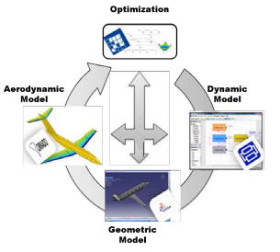
Concept
Multidisciplinary Design Optimization (MDO)
DOMMINIO
Digital method for imprOved Manufacturing of next-generation MultIfuNctIOnal airframe parts
New designs of multifunctional & intelligent airframe parts
Simulation of product & manufacturing
Multistage ATL-FFF manufacuring
Manufacturing online monitoring & NDT data
SHM
MRO
Data-based optimization
Input to process

Slide 6
Concept
Multidisciplinary Design Optimization (MDO)
DOMMINIO
Digital method for imprOved Manufacturing of next-generation MultIfuNctIOnal airframe parts
Lifecycle data
Simulation | Manufacturing | Inservice
New designs of multifunctional & intelligent airframe parts
Simulation of product & manufacturing
Multistage ATL-FFF manufacuring
Manufacturing online monitoring & NDT data
SHM
MRO
Data-based optimization
Input to process

Slide 7
MAIN ROLES

Slide 8
MAIN ROLES
MANUFACTURING
Flexible multistage robotic-based production processes
  Combining ATL and FFF
  cCNT filaments (SHM), CCF and NPs reinforced filaments

Slide 9
MAIN ROLES
MANUFACTURING
Flexible multistage robotic-based production processes
  Combining ATL and FFF
  cCNT filaments (SHM), CCF and NPs reinforced filaments
Quality-by-Design (QbD) manufacturing strategy
  Laser scanning-assisted heating
  FFF nozzle with improved thermal control
  Non-contact ultrasound method for in-line

Slide 10
MAIN ROLES
MANUFACTURING
DIGITAL
Flexible multistage robotic-based production processes
  Combining ATL and FFF
  cCNT filaments (SHM), CCF and NPs reinforced filaments
Quality-by-Design (QbD) manufacturing strategy
  Laser scanning-assisted heating
  FFF nozzle with improved thermal control
  Non-contact ultrasound method for in-line
Data-driven pipeline supporting the design, simulation and production planning
  Numerical simulation of ATL describing in-situ consolidation and FFF quality
  Data processing & Knowledge-based system

Slide 11
MAIN ROLES
MANUFACTURING
DIGITAL
Flexible multistage robotic-based production processes
  Combining ATL and FFF
  cCNT filaments (SHM), CCF and NPs reinforced filaments
Quality-by-Design (QbD) manufacturing strategy
  Laser scanning-assisted heating
  FFF nozzle with improved thermal control
  Non-contact ultrasound method for in-line
Data-driven pipeline supporting the design, simulation and production planning
  Numerical simulation of ATL describing in-situ consolidation and FFF quality
  Data processing & Knowledge-based system
Monitoring and Management of the Health of multifunctional
  Strain sensor based on cCNT-fibres
  Digital Twin technology for SHM&M of the multifunctional composite
  Develop advanced multi-scale models for virtual testing

Slide 12
MAIN ROLES
MANUFACTURING
DIGITAL
Flexible multistage robotic-based production processes
  Combining ATL and FFF
  cCNT filaments (SHM), CCF and NPs reinforced filaments
Quality-by-Design (QbD) manufacturing strategy
  Laser scanning-assisted heating
  FFF nozzle with improved thermal control
  Non-contact ultrasound method for in-line
Data-driven pipeline supporting the design, simulation and production planning
  Numerical simulation of ATL describing in-situ consolidation and FFF quality
  Data processing & Knowledge-based system
Monitoring and Management of the Health of multifunctional
  Strain sensor based on cCNT-fibres
  Digital Twin technology for SHM&M of the multifunctional composite
  Develop advanced multi-scale models for virtual testing

Slide 13
SPECIFIC TARGETS
Flexible multistage robotic-based production processes
KPI 1: 25% manufacturing cost reduction. The use of cost-effective, flexible and near-net-shape automated processes together with zero-defect-manufacturing approaches will significantly reduce manufacturing costs.
Novel data-driven pipeline supporting the design, simulation and production planning
KPI 2: 25% reduction of product and process design time through agile multidisciplinary product and process simulation tools, data analytics and knowledge-based decision support system.
Quality-by-Design (QbD) manufacturing strategy
KPI 3: 15% reduction in scrap during manufacturing using advanced ATL/AM multistage manufacturing, online process control and advanced quality monitoring that, together with the data-driven pipeline and knowledge-based system, will enable a paradigm shift towards right-first-time and Zero-defect manufacturing approaches.
New digital-combined-physical driven methodology for Monitoring and Management of the Health
KPI 4: 20% component weight reduction. Information of in-service material structural performance will be introduced in the new MDO platform and together with new advanced manufacturing routes based on the combination of flexible ATL and AM processes will enable new airframe components lightweight design.
KPI 5: 30% cost reduction in MRO operations enabled by the easy-to-disassembly designs, TPCs increased reparability (50% reduction in repair times based on thermoplastic reversible melting behaviour (welding / in-situ consolidation) compared to Thermoset Composites) and the decrease of unnecessary replacements and unscheduled grounding repairs using embedded SHM systems and component digital twin, which will support the optimization of scheduled MRO and real-time decision making.
KPI 6: In the long term, reduce time and cost of current certification processes by accelerating the standardization of virtual certification.

Slide 14
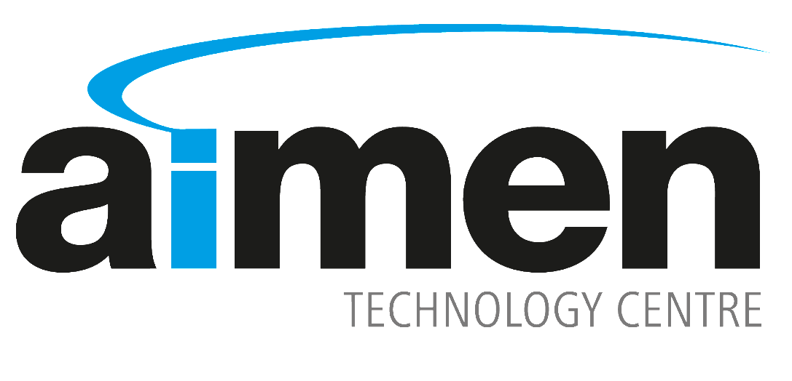












Pablo Romero Rodríguez | R&D Program Manager - DOMMINIO Project Coordinator
+34 672 62 35 49 | pablo.rodriguez@aimen.es

