Slide 1
Data Spaces in Digital Manufacturing:
opportunities and challenges
DOMMINIO Open Workshop
Next generation airframe parts
Sergio Gusmeroli
Research Coordinator at Politecnico of Milano
sergio.gusmeroli@polimi.it
November 30th 2021

Slide 2

European strategy for data
European Data Space
9
How to realize?
Data spaces in key sectors
FAIR, High Value pools of Data
Infrastructure to use and exchange data
Appropriate governance models / mechanisms
Manufacturing
Green
Mobility
Health
Finance
Energy
Agriculture
Public Administration
Skills
www.internationaldataspaces.org
Notes:
The main goal of European Data Space is to increase the availability [uh –vey-luh-bih-lih-ty] of large pools of data, of course, the availability of an infraestructure to use and exchange data and appropriate Governance mechanisms.
The EC is promoting 9 data spaces in key sectors.
How to realize this? What can we really do now to create one EU data space and not to create 9 data silos again?

Slide 3

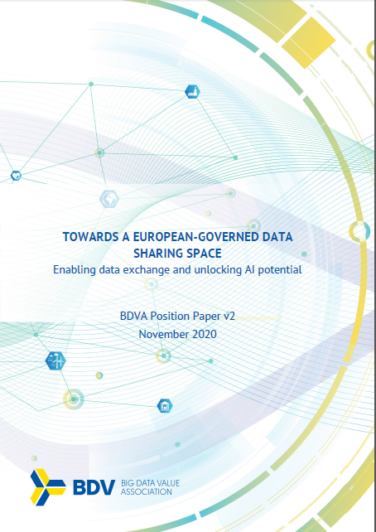
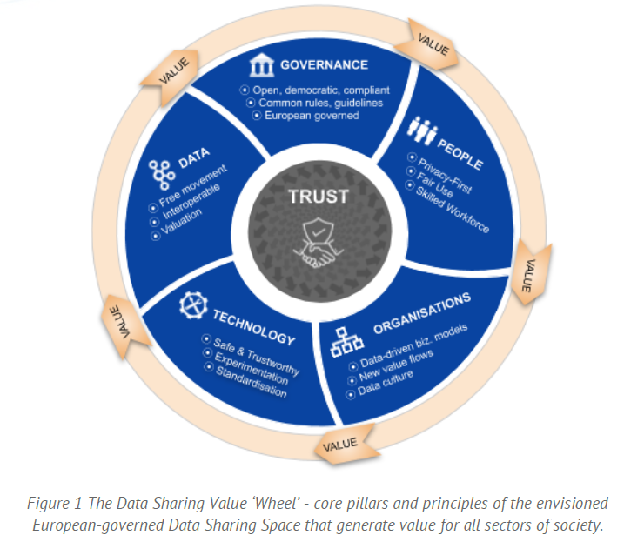
Data Sharing Value Wheel in BDVA / DAIRO
LINK to the BDVA PAPER

Slide 4

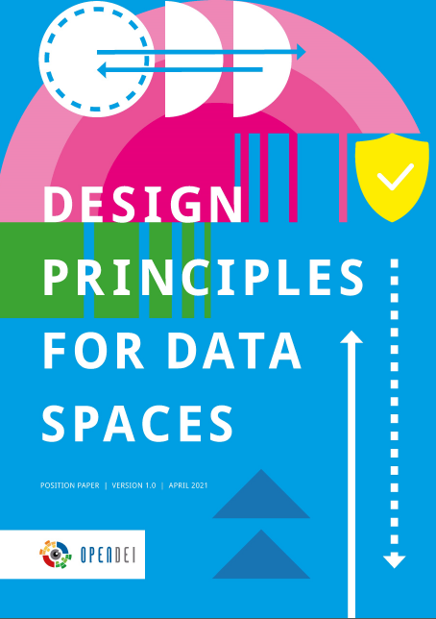
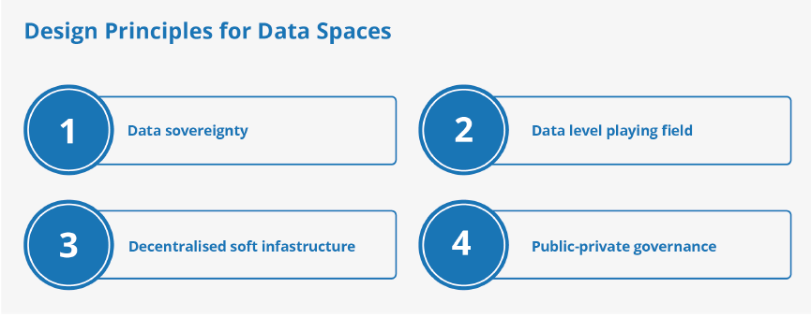
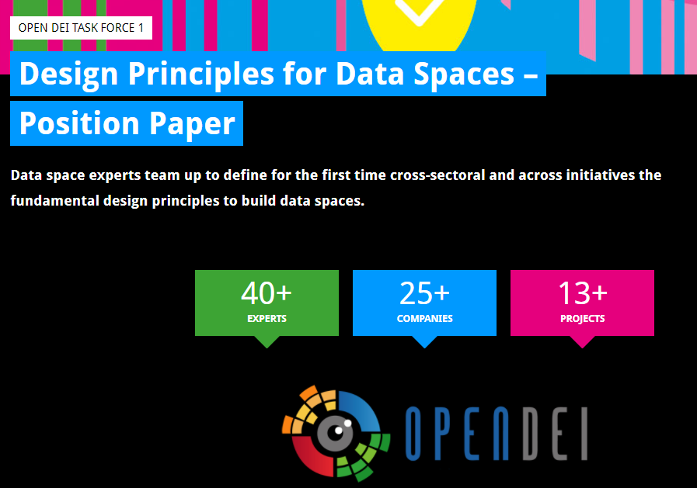
Design Principles for Data Spaces in OPENDEI / IDSA
LINK to the OPENDEI IDSA PAPER

Slide 5
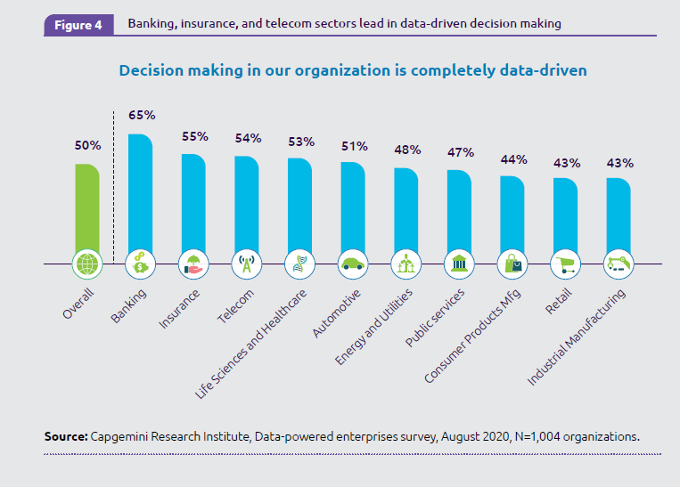

Data Spaces for Manufacturing: the User Story (CAPGEMINI RI)

Slide 6
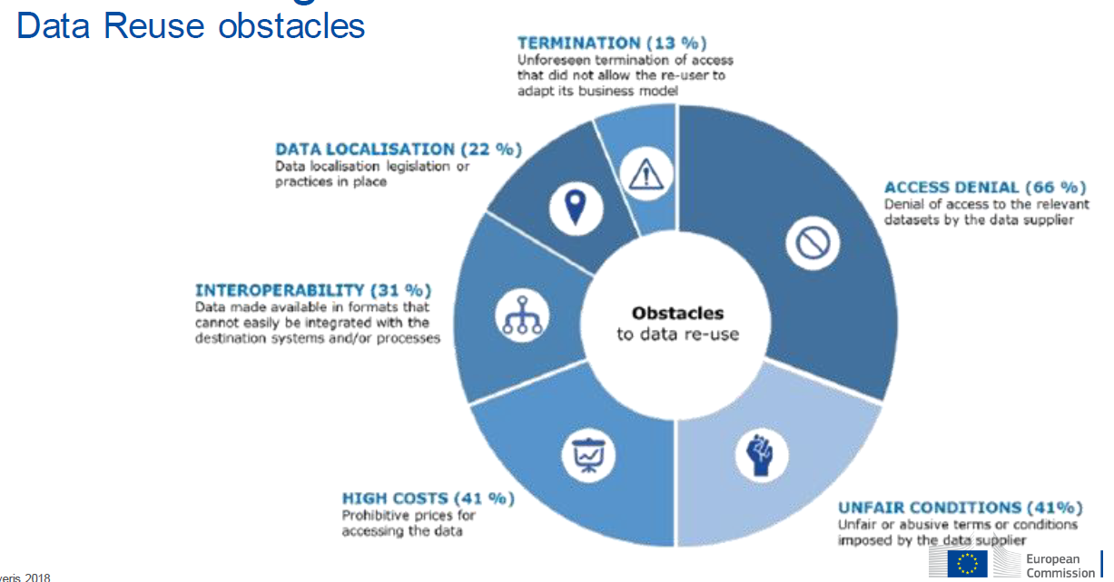
Data Spaces for Manufacturing: the User Story (EVERIS for EC)

Slide 7

The five Levels of the DS Pathway
5) Data Valorisation
This level is when the enterprise fully understands how data can be profitably exploited inside and outside of the value chain. Data Marketplaces and/or Trusted Data Networks are setup and managed in agreement with Data Protection (personal data) and Data Sovereignty (non-personal data) principles. This does not necessarily imply a monetisation and revenue stream, but the full exploitation of the intrinsic value of data-information-knowledge
4) Data Interoperability
This is a level where enterprises define a strategy and a set of processes for managing and governing the Data generated inside and acquired from outside along their complete lifecycle. Data Spaces are generated where common standard data models, ontologies, industrial data platforms are set up inside the company and along the product lifecycle and the value chain. Any new application can be easily plugged & played in this data space just by configuration, so that scalability is assured.
3) Data Bridges
1) No Data Control
This is a level where companies do not have CONTROL of DATA along their lifecycle. DATA are of course generated but no models, no processes, no awareness is in place. Smart Machines, Smart Products and Smart Value Chains do produce data but they are dispersed in several areas and the company does not have any control on them
2) Data Silos
This is a level where the company understands the relevance of Data lifecycle management as for feeding Enterprise applications such as PLM ERP SCM CRM MES … Data are captured …. Visualized in the context of their Enterprise application, so some data is NOT managed, some data is duplicated, but in any case DATA is SILOED.
This is a level where for feeding some advanced applications in the domain of planning, optimisation, prediction, the company needs to integrate data from different sources (e.g. ERP-CRM; ERP-MES, PLM-MES). Ad-hoc integration bridges are developed but without a holistic and comprehensive strategy for data management and governance

Slide 8
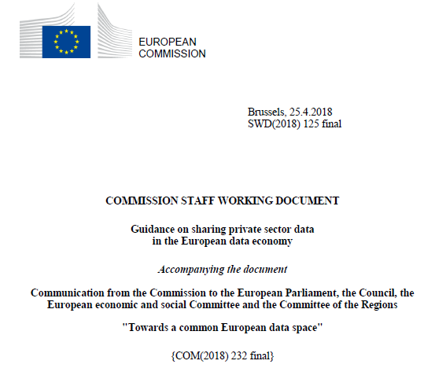

Business Models for sharing Private sector Data
Models to B2B Data Exchange
a) An Open Data approach: The data in question are made available by the data supplier to an in principle open range of (re-)users with as few restrictions as possible and against either no or very limited remuneration.
b) Data monetization on a data marketplace: Data monetization or trading can take place through a data marketplace as an intermediary on the basis of bilateral contracts against remuneration. Suitable when either (1) there are limited risks of illicit use of the data in question, (2) the data supplier has grounds to trusts the (re-)user, or (3) the data supplier has technical mechanisms to prevent or identify illicit use.
c) Data exchange in a closed platform: Data exchange may take place in a closed platform, either set up by one core player in a data sharing environment or by an independent intermediary. The data in this case may be supplied against monetary remuneration or against added-value services, provided e.g. inside the platform.

Slide 9
Embryonic Data Spaces in Smart Manufacturing
Industry ecosystem
The EC viewpoint
Matthias Kuom

Slide 10






Digital Europe Programme: recap the main objectives
strategic autonomy
Compete globally
Other regions of the world invest huge amount of public capital in advanced technologies. For example, the US and China spend € 10-20 billion annually on AI alone
Achieve scale through collective co-investments
Given the size of investments needed, scale required and risks involved Europe needs to pool the resources together
Regain control over Europe’s value chains
and ensure Europe’s technological sovereignty
Better address Europe’s economic and societal challenges
  E.g. climate, health, mobility and public services
Ensure broad take-up of digital technologies across all regions of EU
  In deploying latest technologies to offer best services to citizens and business
Support SMEs to acquire or access the latest technologies and skills
More than 400,000 EU vacancies in these fields

Slide 11


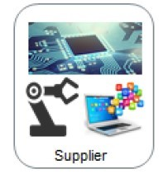


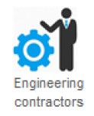


Manufacturing Data Spaces: two scenarios*
Agile supply chain management and execution by continuously monitoring and exchanging status data across the value chain
Dynamic asset management and predictive/prescriptive maintenance by continuously monitoring and exchanging industrial data
Manufacturer
Example inspired by SECOIIA
Example
*NOTE. A product life cycle scenario, materials modelling and circular economy in Horizon EU,
Destination 1 TWIN TRANSITION, Destination 2 RESILIENCE and Destination 3 DATA

Slide 12
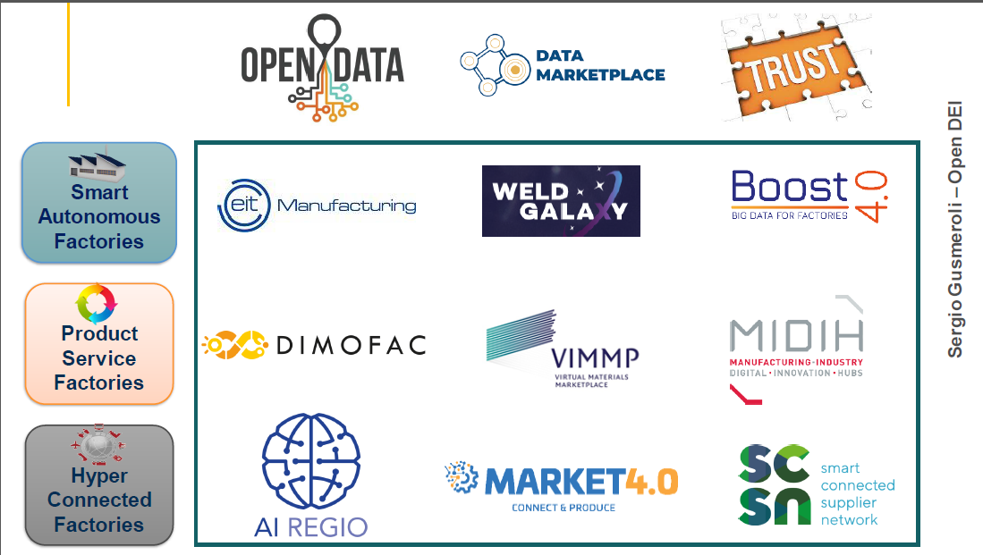



Data Spaces for Manufacturing: the EC Perspective, Embryonic DS

Slide 13
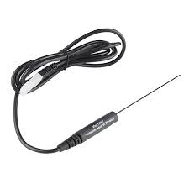
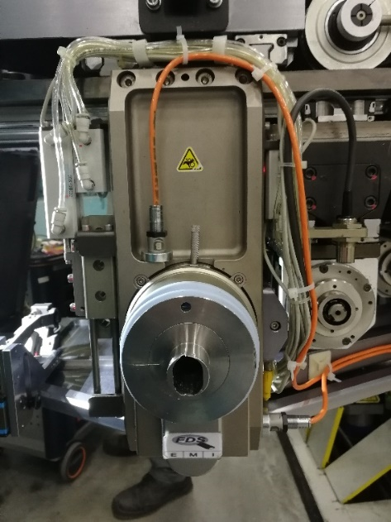
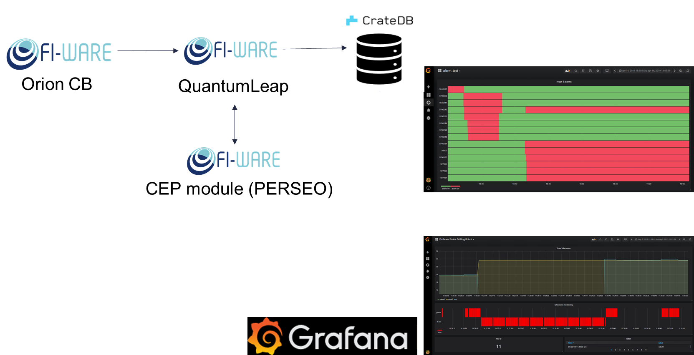
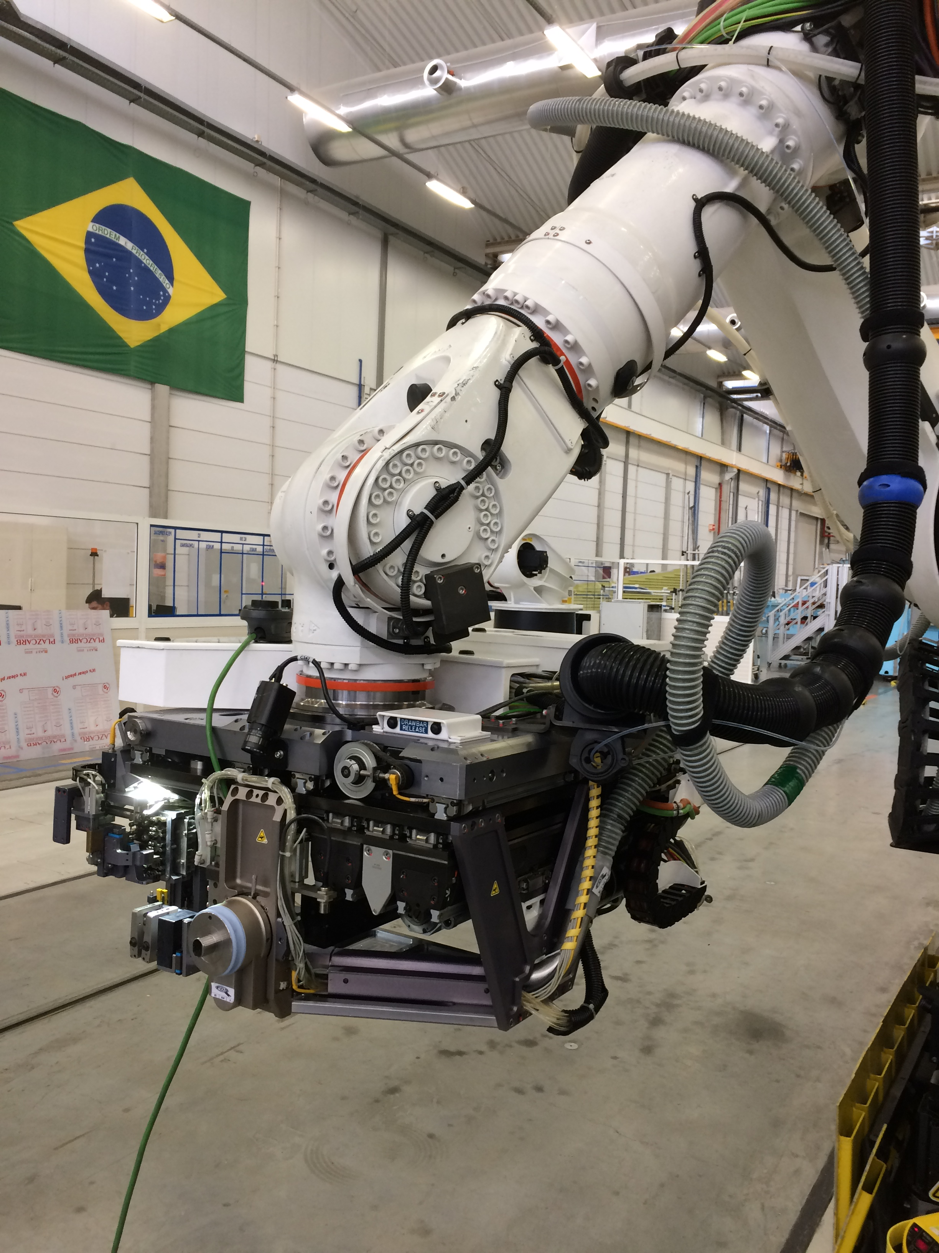
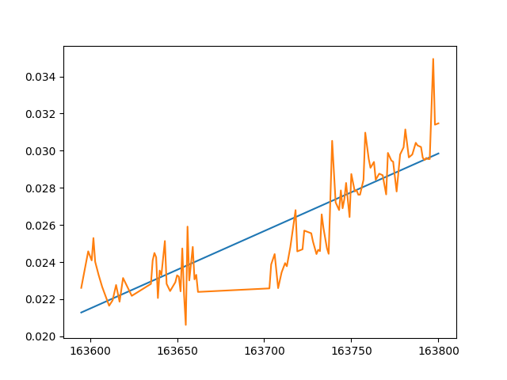
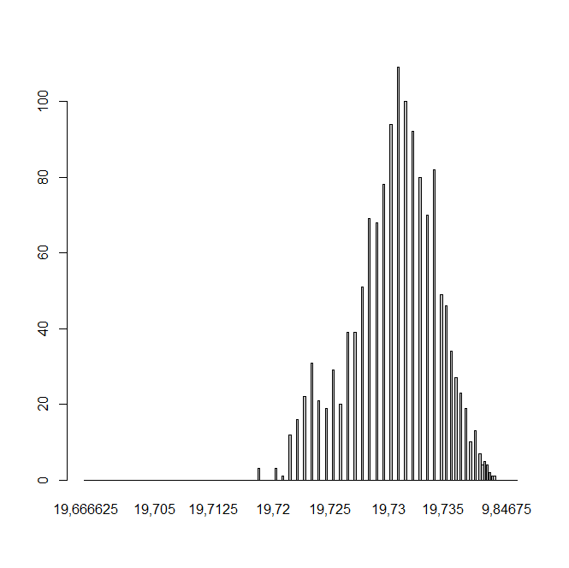
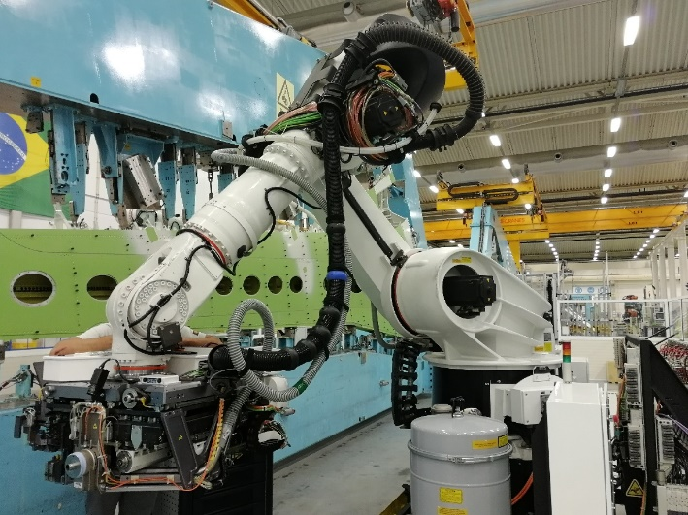
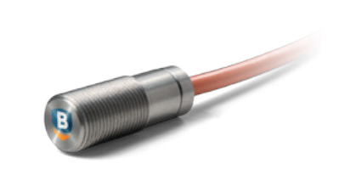
Data Spaces for Industrial IoT in Aero: Drilling Robot Monitoring
APM
Probe sensor
GATEWAY (Siemens IoT 2040
Modbus RTU

Slide 14
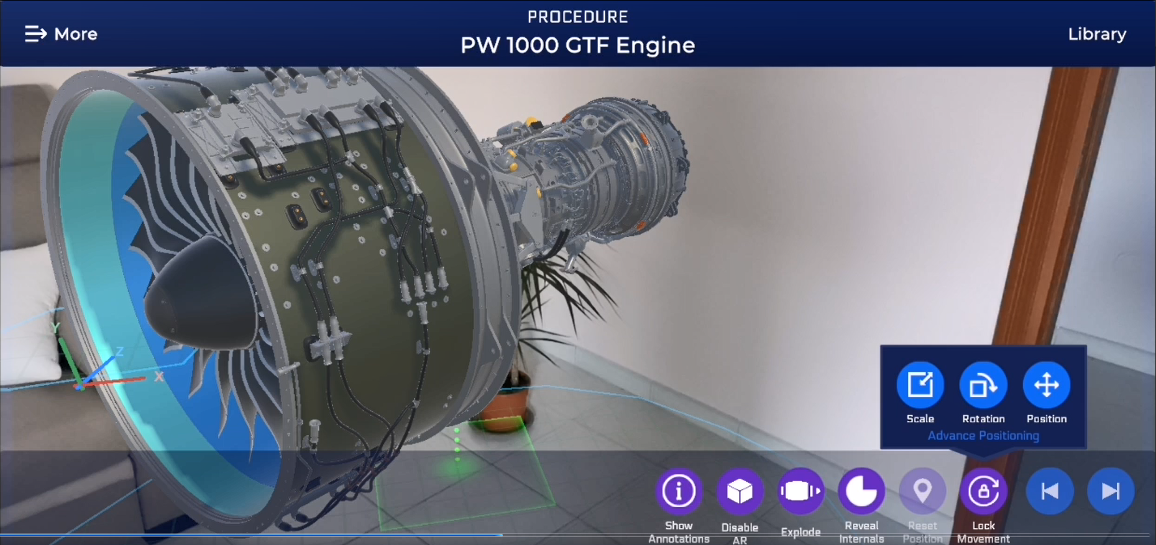
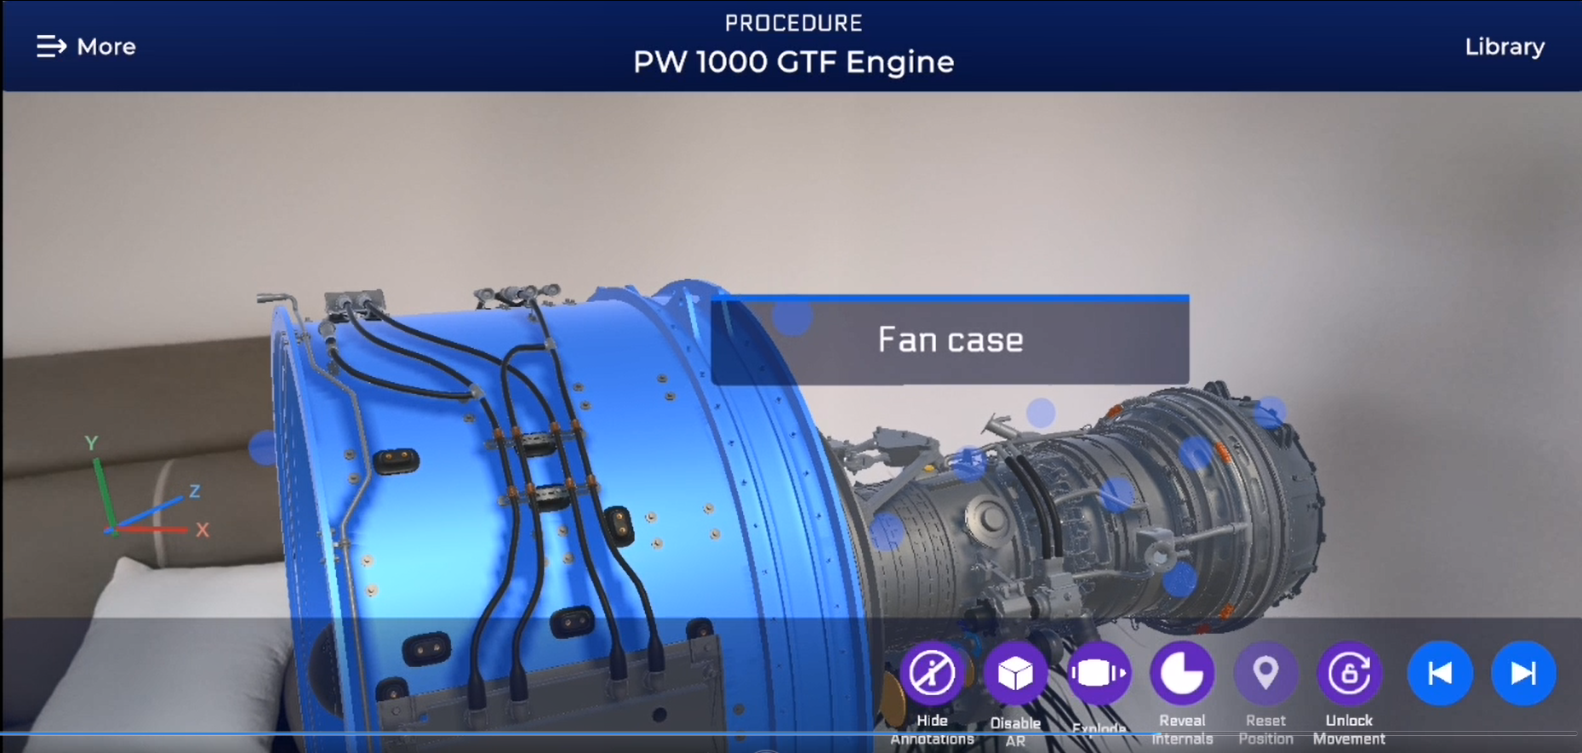



Data Spaces for VR/AR in Aero: Operations Support in Assembly
Technicians always connected to the latest version of procedures providing contextualized support. Technicians always connected to the latest version of procedures providing contextualized support
Input
Assembly instructions
Procedure execution video
Output
Augmented Reality assembly application working on Augmented Reality Headset (HoloLens/Vuzix), tablet/smartphones

Slide 15
Data Spaces in Digital Manufacturing:
opportunities and challenges
THANK YOU!!!
DOMMINIO Open Workshop
Next generation airframe parts
Sergio Gusmeroli
Research Coordinator at Politecnico of Milano
sergio.gusmeroli@polimi.it
November 30th 2021

